Slide 1
Sales Forecast for Inventory Management
Tirthraj Bhatt https://github.com/tirthmagnus Cs 668

Slide 2
Project Proposal
Problem: Develop a sales forecasting model for inventory management which will assist the business owners to tackle over stock & under stock kind of problems.
Research Question: Can we accurately predict sales quantity for each item in a business's inventory for the upcoming quarter and year?
Dataset: Proprietary historical sales data with item details, quantities, and dates, 35k rows of data.
Motivation:
-> Business: Improve inventory management,overstock,understock and profitability.
-> Technical: Apply data science techniques to solve real-world business challenges.

Slide 3
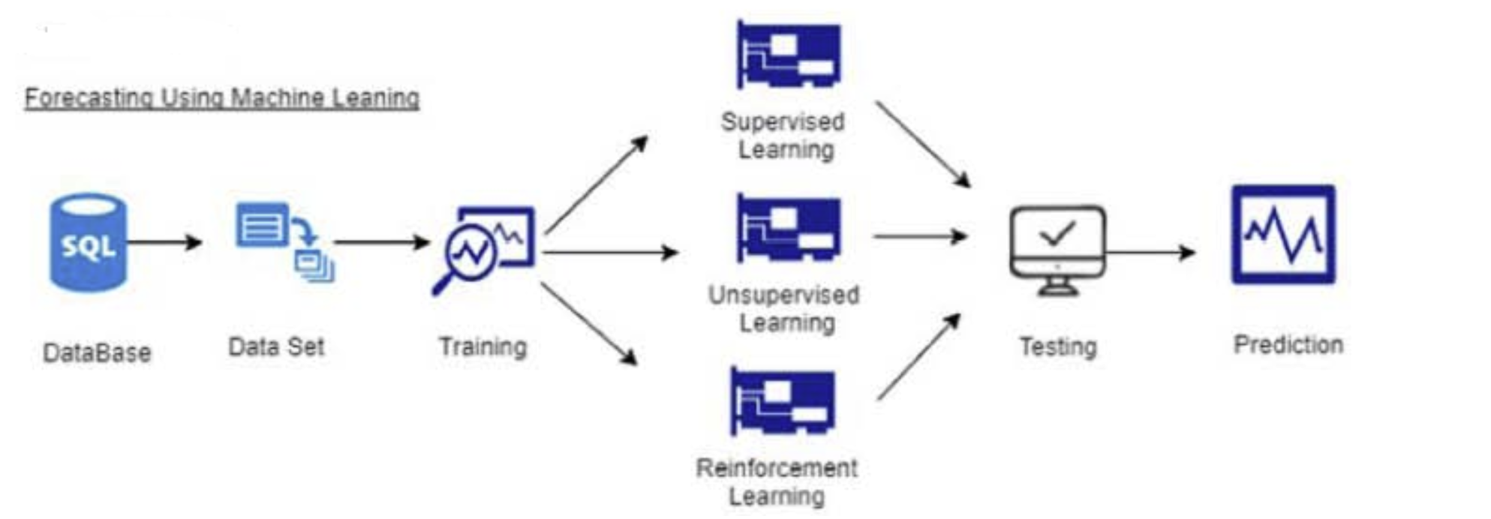
An approach for sales forecasting
Goal:-
The abstract discusses the problem of inaccurate sales forecasting in retail and introduces a model called SalesKBR. This model combines the Best-Worst Method (BWM), k-Means, and the RFM model to enhance forecasting accuracy. Key factors affecting sales include frequency, quantity, and monetary value. Sales-KBR shows promise as a valuable tool for improving retail sales predictions.
Dataset:- Not Specified
Methodology :-
The research paper's methodology involves developing the SalesKBR retail sales forecasting model, which integrates the Best-Worst Method (BWM) for criteria extraction and k-Means clustering with six validity indices to enhance product clustering within the Recency-Frequency-Monetary (RFM) framework. This innovative approach aims to improve the accuracy of retail sales forecasts and address the limitations of classical statistical methods. The study utilizes historical sales data and related variables in its methodology, ultimately identifying frequency, quantity, and monetary factors as crucial for retail sales forecasting.
Result :-
The results of the study indicate that the SalesKBR model offers a reasonable level of accuracy in retail sales forecasting. Key criteria identified as significant for forecasting are frequency, quantity, and monetary factors.
Article Link :- https://doi.org/10.1016/j.eswa.2022.118043

Slide 4
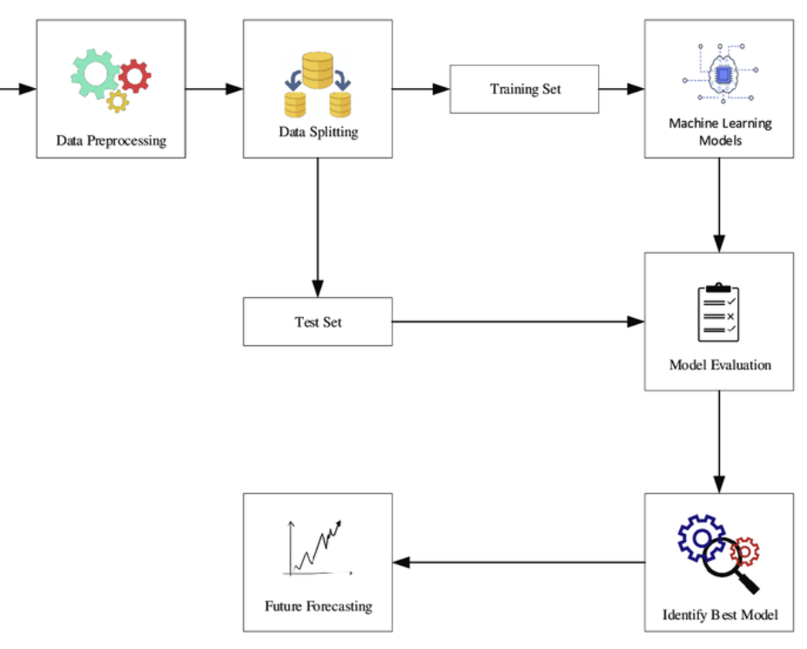
Application of Machine Learning Model and Hybrid Model in Retail Sales Forecast
Goal :-
The research paper's main goal is to improve the precision of retail sales forecasting, focusing on seasonal and holiday effects, using Walmart sales data. It evaluates traditional time series models and machine learning models like the Prophet and LightGBM to identify the most effective method for sales prediction in the retail industry. The study aims to offer insights for retailers to enhance their sales forecasts, aiding in resource planning and decision-making.
Dataset :- Walmart sales dataset
Methodology :-
The paper's methodology compares various sales forecasting models, including traditional time series (e.g., ARIMA and SARIMA), newer models like the Prophet and LightGBM, and assesses their performance on Walmart sales data. It includes data preprocessing, model training, and parameter optimization. The goal is to identify an effective model for retail sales prediction.
Results:-
The research indicates that the LightGBM machine learning model outperforms the Prophet model and traditional time series methods in forecasting Walmart sales. LightGBM demonstrates lower prediction errors, making it a promising approach for retail sales forecasting.
Article Link :- https://ieeexplore.ieee.org/document/9403224

Slide 5
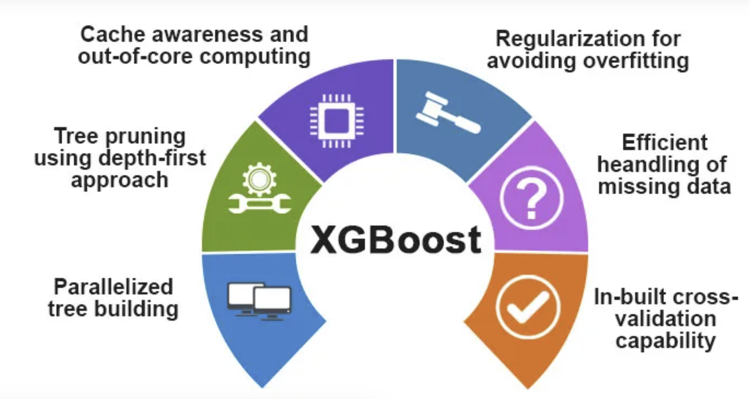
Sales forecasting of bigmart dataset using supervised and ANN algorithms
Goal :-
The goal of this research is to create an accurate sales prediction model for Big Mart stores using supervised and artificial neural network algorithms. This model will help optimize business strategies, improve inventory management, and enhance demand forecasting by analyzing the relationship between product attributes, store characteristics, and sales performance.
Dataset :- Bigmart dataset
Methodology :-
The methodology involves employing machine learning techniques, specifically Random Forest Regression, XGBoost, Linear Regression, Lasso Regression, and Artificial Neural Networks (ANN), to predict sales for Big Mart stores. Data preprocessing and cleaning are performed to handle missing values and outliers. The study explores univariate, bivariate, and multivariate analyses, as well as correlation matrix assessments. Various regression models are trained and evaluated to achieve accurate sales predictions.
Results :-
The study conducted various regression models to predict sales for Big Mart stores. The Random Forest Regression model exhibited the best performance with a Mean Absolute Error of 780.11 and an R^2 Score of 0.59, indicating its suitability for accurate sales prediction. This research provides insights into effective sales forecasting techniques for retail businesses.
Article Link :- https://www.sciencedirect.com/science/article/pii/S2665917422000228

Slide 6
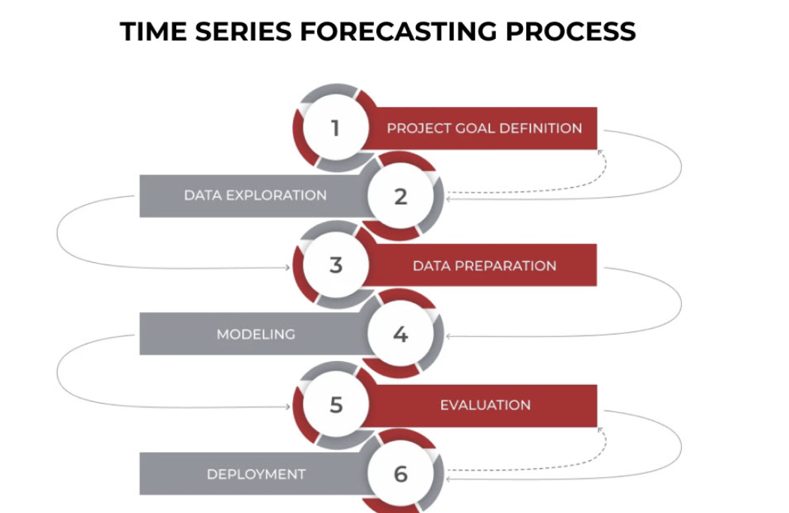
Time-series forecasting of seasonal items sales using machine learning – A comparative analysis
Goal :-
The goal of this research is to predict future furniture sales using a public retail store dataset. The study aims to evaluate and compare the performance of various forecasting models, including traditional methods like SARIMA and advanced techniques such as LSTM and CNN. By doing so, it seeks to identify the most accurate method for seasonal sales forecasting in the context of furniture retail.
Dataset :- Superstore dataset (community.tableau)
Methodology :-
The study utilizes data preprocessing, model selection (SARIMA, Exponential Smoothing, Prophet, and Neural Networks), performance assessment (MSE, RMSE, MAPE), and a 75% training-25% test set split for time-series forecasting.
Results :-
Neural networks, including Stacked LSTM and CNN, outperformed classical methods in predicting seasonal furniture sales. The Prophet model performed well, especially when considering holidays. Five models achieved acceptable accuracy (RMSE: 128.51). Future research can refine models, apply them to other items, and explore hybrid forecasting methods.
Article Link :-https://www.sciencedirect.com/science/article/pii/S2667096822000027#sec0029

Slide 7
An approach for sales forecasting
Goal:-
To improve sales forecasting accuracy in the fashion retail industry, leveraging deep learning techniques, a diverse range of product variables, and expert insights. The objective is to develop models that can predict sales for new fashion products efficiently and compare the performance of deep learning against traditional techniques.
Dataset :- Fashion dataset (Not specified)
Methodology :-
This study improves fashion retail sales forecasting by predicting sales of new products. It uses deep learning and compares it with traditional methods like Decision Trees, Random Forest, and more. The goal is to assess if deep learning enhances sales predictions, aiding inventory and purchasing strategies.
Results :-
The results show that deep learning models provide good sales predictions for fashion retail, although they are not significantly better than some traditional methods, such as Random Forest, across various evaluation metrics.
Article Link:- https://doi.org/10.1016/j.eswa.2022.118043

Slide 8
Machine Learning Model for Sales Forecasting by Using XGBoost
Goal:-
The goal is to create an effective sales forecasting model using machine learning, with a focus on XGBoost. The objective is to enhance sales prediction accuracy for retail companies, enabling better decision-making and resource optimization.
Dataset :- Walmart dataset (1913 days)
Methodology :-
The methodology involves feature engineering, including outlier detection, data type conversion, and the extraction of time-based and statistical features from the sales data. Subsequently, XGBoost, a gradient boosting tree model, is applied for sales forecasting. Data preprocessing, feature selection, and the use of XGBoost are the core components of the methodology.
Results :- The proposed XGBoost-based sales forecasting model outperforms traditional machine learning models with a Root Mean Squared Scaled Error (RMSSE) of 0.655, while Linear Regression achieves 0.783 and Ridge Regression reaches 0.774. The XGBoost model demonstrates superior performance in sales forecasting.
Article Link :-https://ieeexplore.ieee.org/stamp/stamp.jsp?tp=&arnumber=9342304

Slide 9
Project Proposal
Problem: Develop a sales forecasting model for inventory management which will assist the business owners to tackle over stock & under stock kind of problems.
Research Question: Can we accurately predict sales quantity for each item in a business's inventory for the upcoming quarter and year?
Dataset: Proprietary historical sales data with item details, quantities, and dates, 35k rows of data. Columns : Date, Year, Month, Customer Age, Customer Gender, Country, State, Product Category, Sub Category, Quantity, Unit Cost, Unit Price, Cost, Revenue
Source : https://data.world/vineet/salesdata Description : Size :35000 rows X 15 Columns
Motivation:
-> Business: Improve inventory management,overstock,understock and profitability.
-> Technical: Apply data science techniques to solve real-world business challenges.

Slide 10
Literature Review
The literature review emphasizes the importance of Exploratory Data Analysis (EDA) in uncovering insights from sales data.EDA is a foundational step in the data analysis process, allowing for data understanding, pattern recognition, and initial hypothesis formulation.EDA techniques, such as summary statistics, data visualization, and data cleaning, play a critical role in revealing data quality issues and trends within the dataset.The data literature underscores the significance of visualizations, including bar charts, box plots, and scatter plots, in understanding data distributions and relationships between variables.
Key Learnings :
In our exploration of sales data, we've unearthed valuable insights that underscore the significance of data-driven decision-making. Through Exploratory Data Analysis (EDA), we've identified crucial data quality factors, patterns, and trends. The visualizations and data preprocessing steps have set the stage for more advanced predictive modeling Data Driven Approach :
Arima,Prophet and LSTM model can used for the solving the mentioned problem which will help in forecasting the sales in terms of quantity and in terms of revenue which will help the stakeholders in managing the inventory in best way possible and overcoming the problem like understock and overstock leading in increase in profit asd reducing the operational cost.

Slide 11
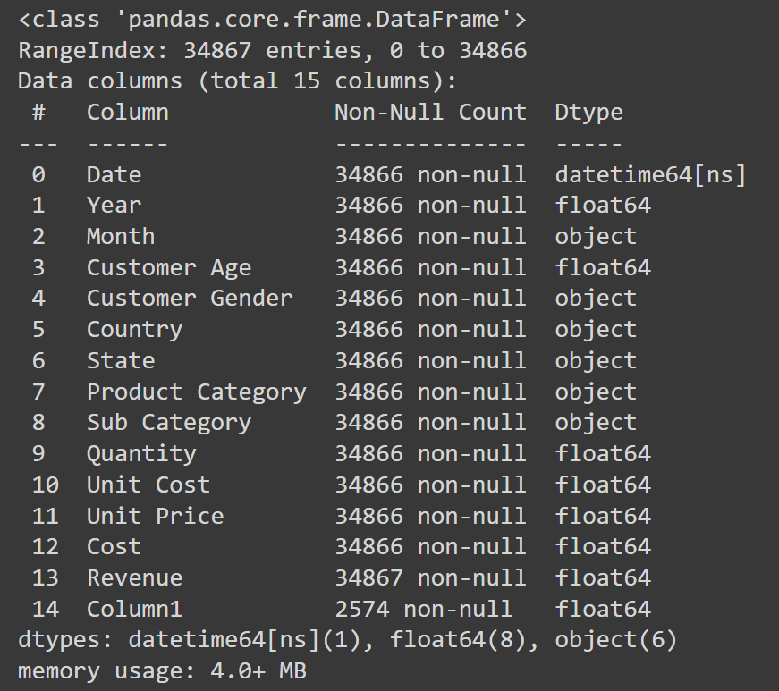
Dataset
https://data.world/vineet/salesdata
Sales Data
Total Fields :- 15 Total Records :- 34,876 Crawled on :- 2017

Slide 12
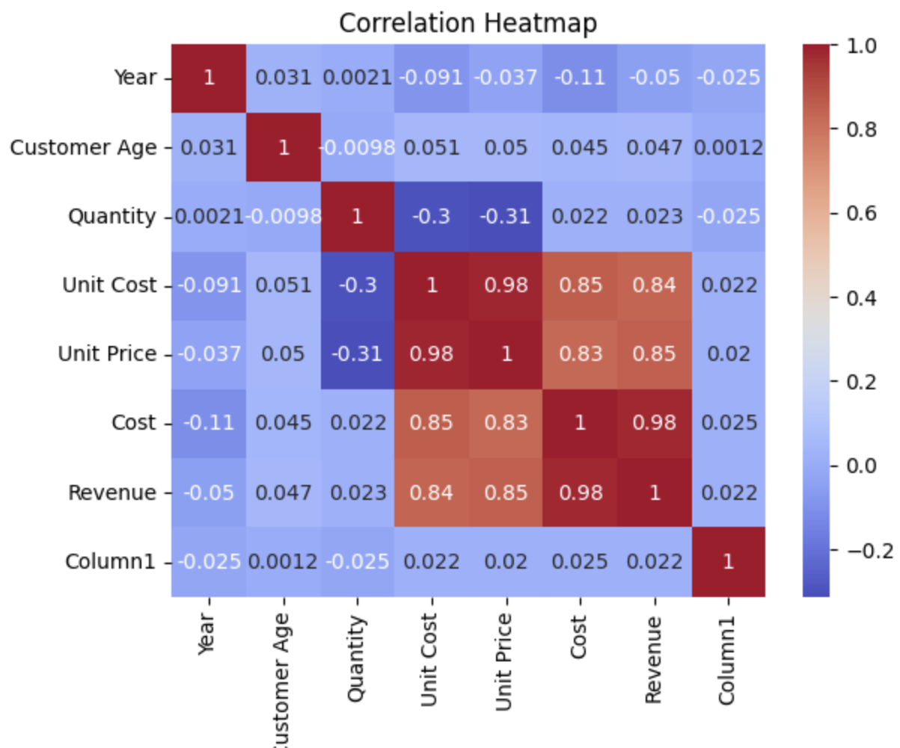
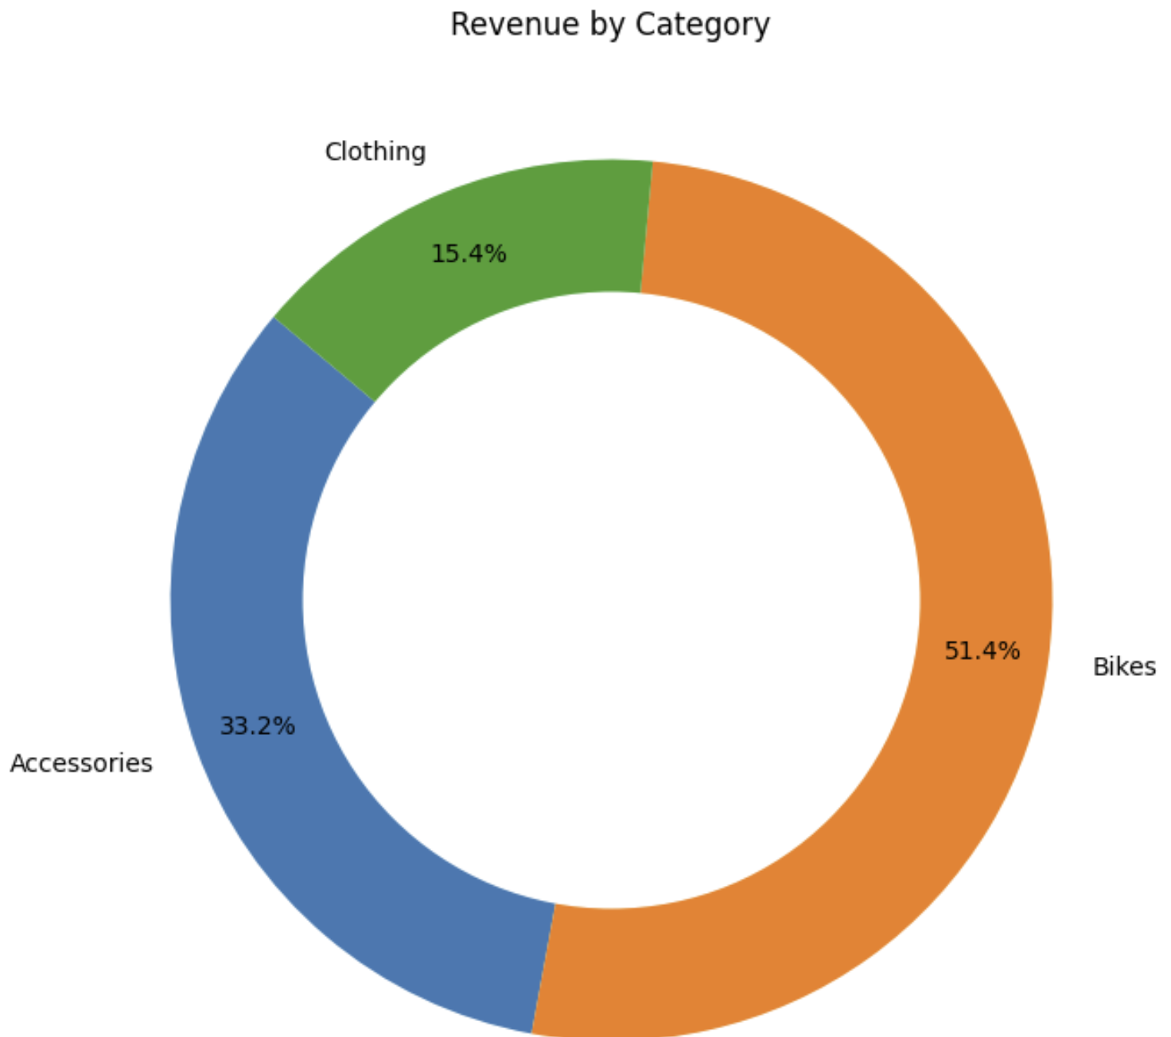
EDA & Methodology
Year and Month: Strong negative correlation (-0.81), indicating months within a single year.
Customer Gender and Age Group: Very weak positive correlation (0.027).
Country and Age Group: Moderate positive correlation (0.097).
Product Category and Sub Category: Very weak negative correlation (-0.02).
Quantity and Unit Cost, Unit Price, Cost, Revenue: Weak correlations with 'Unit Cost' (negative), 'Unit Price' (negative), 'Cost' (positive), and 'Revenue' (positive).
Unit Cost, Unit Price, Cost, Revenue: 'Unit Cost' strongly positively correlated with 'Cost' and 'Revenue'. Similarly, 'Unit Price' strongly positively correlated with 'Revenue'.
Age Group and Revenue: Very weak positive correlation (0.015).
Here in this Visual it is shown how the revenue distribution for top category
Bikes as highest contributor 51.4%
Accessories with 33.2%
Clothing with 15.4%

Slide 13
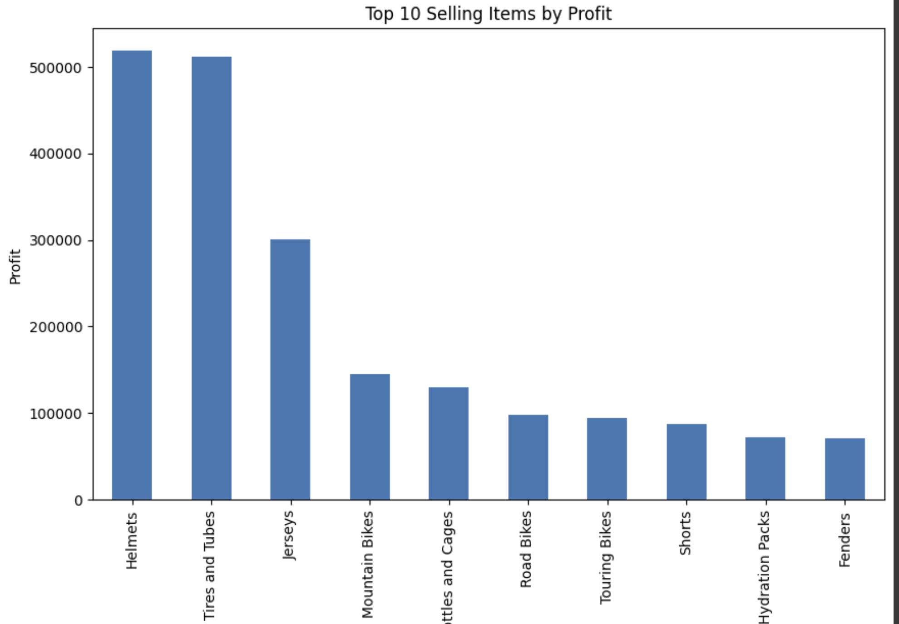
Top 10 selling items in terms of profitability

Slide 14
Next Steps
1. Data Refinement: Address data quality issues, perform feature engineering.
2. Model Selection: Choose the right model for time series forecasting.
3. Performance Evaluation: Assess model accuracy using metrics like MAE and RMSE.
4. Hyperparameter Optimization: Fine-tune model parameters for enhanced forecasts.
5. Ensemble Methods: Experiment with ensemble models like XGBoost.
6. Cross-Validation: Validate model stability with k-fold cross-validation.
7. Deployment and Monitoring: Deploy the model for real-time predictions and continuous monitoring.
These steps will lead to a robust sales forecasting solution, enabling data-driven decision-making and improved inventory management.

Slide 15
Machine Learning and model Implementation
1. Model Selection:
- Chose Random Forest Regression due to its ability to handle complex relationships, capture feature importance, and minimize overfitting.
2. Data Preprocessing:
- Conducted extensive exploratory data analysis (EDA) to understand the dataset's structure and patterns.
- Applied data encoding, standard scaling, and log transformation to handle categorical variables, scale features, and address skewness in the target variable (Revenue).
3. Feature Engineering:
- Created age groups for customers and mapped months to numerical values for enhanced model interpretability.
- Utilized Label Encoding for categorical variables to facilitate model training.
4. Outlier Detection:
- Employed the IQR method to identify and handle outliers in the Revenue column, ensuring model robustness.
5. Model Training
- Split the data into training and testing sets (80-20 split) and standardized features using StandardScaler.
- Trained the Random Forest Regression model on the training data with 100 estimators.
6. Performance Evaluation:
- Evaluated model performance on the testing set using regression metrics like MSE, MAE, and R-squared.
- Checked for overfitting by assessing training set metrics, cross-validation scores, and tuning the model.
7. Feature Importance:
- Visualized and interpreted feature importance using a bar plot, offering insights into the key factors influencing revenue predictions.
8. Conclusion:
- Concluded with a comprehensive assessment of model effectiveness, addressing skewness, and providing strategic implications for future business forecasting.

Slide 16
References
ACM Style:
1. Application of Machine Learning Model and Hybrid Model in Retail Sales Forecast. (n.d.). IEEE Xplore. Retrieved from
Authors :- Haichen Jiang, Jiatong Ruan, Jianmin Sun Link:- https://ieeexplore.ieee.org/document/9403224
2. Time-series forecasting of seasonal items sales using machine learning – A comparative analysis Authors :- Yasaman Ensafi , Saman Hassanzadeh Amin, Guoqing Zhang , Bharat Shah Link:- https://www.sciencedirect.com/science/article/pii/S2667096822000027#sec0029

Slide 17
Project Proposal
Problem: Develop a sales forecasting model for inventory management which will assist the business owners to tackle over stock & under stock kind of problems.
Research Question: Can we accurately predict sales quantity for each item in a business's inventory for the upcoming quarter and year?
Dataset: Proprietary historical sales data with item details, quantities, and dates coming from the POS of Retail store, 35k-45k rows of data.
Motivation:
-> Business: Improve inventory management,overstock,understock and profitability.
-> Technical: Apply data science techniques to solve real-world business challenges.

